Slide 1

WORKING OF COST
CONTAINMENT

Slide 2

Cost Containment in Health care
IN THE HEALTHCARE SECTOR, COST CONTAINMENT HEALTH CARE SOFTWARE CAN BE TERMED AS A STATE THAT INCLUDES SOME BUSINESS PRACTICE METHOD THAT HELPS MAINTAIN OR REDUCE EXPENSES OF PRODUCT OR SERVICES TO AVOID UNNECESSARY SPENDING, RESULTING IN A MAXIMUM FEASIBLE OUTCOME.
Cost containment is one of the ways in which healthcare organizations will attempt to control costs within their organizations. Although cost containment can be applied across an organization as a whole, it is most often applied to individual processes in order to reduce costs and increase efficiency.
Cost containment health care identifies areas where costs might arise and mitigates that risk by ensuring the process, department, or individual does not exceed established limits. Organizations must be able to identify where the cost is likely to occur and take the necessary steps to ensure the process is as efficient as possible.

Slide 3
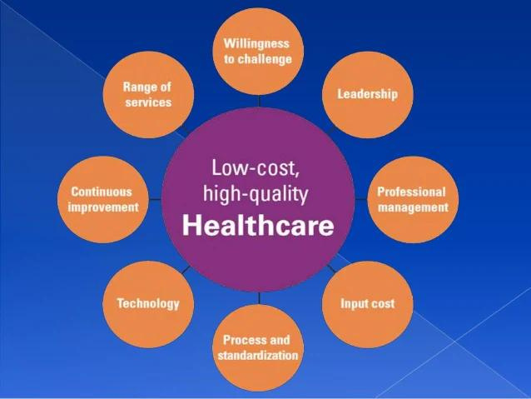
This is How Cost Containment Works

Slide 4

Solution Design & Development
Cost-containment services efficiently review current contracts and historical invoices to identify billing errors and ensure accurate repricing.
Healthcare cost management solutions utilize proprietary telecom insights to render benchmark metrics, implement market-leading payment agreements or review alternative solutions.
Cost containment software solutions facilitate integrated payment solutions to streamline provider fulfillment.

Slide 5
Challenges in Cost Containment
The traditional reimbursement models in healthcare are facing paramount transformation to mutually beneficial healthcare cost management solutions.
Software solutions providers forefront of providing cost containment solutions to the healthcare payers that play a vital role in reducing overutilization, identifying the areas to minimize healthcare spending, and enhancing transparency.
The cost containment software solutions empower the payer organizations with robust knowledge management and utilization of leading medicare benchmarking tools. By auditing medical accounts, PPO network administration, and PPO repricing, our healthcare cost management solutions automate and improve the claim cycle and transparency.

